Slide 1
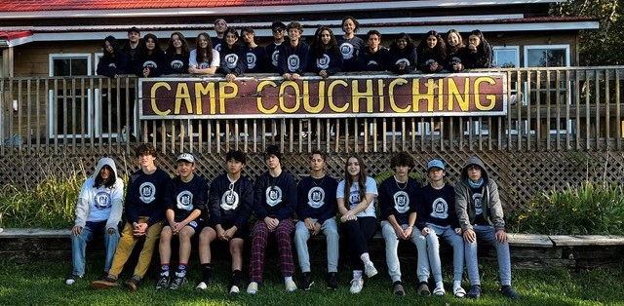
Ontario Educational Leadership Centre (OELC)
OELC, the benchmark in youth leadership development!

Slide 2
Custom Leadership Programs
Customized curriculum to meet each individual school’s objectives
Led by qualified and experienced teacher facilitators, with a ratio of one facilitator to 15-20 students
Students leave OELC with an “action plan” that they can readily apply to their schools, their community, and their own lives
OELC empowers youth as agents of positive change, to maximize their leadership potential
Programs foster emotional intelligence, self-confidence, independence, healthy living, environmental awareness, leadership and more!

Slide 4
On Location at Camp Couchiching
Grades 6-12
May-June; September-October
3 days, 2 nights on beautiful Lake Couchchiching, Longford Mills just outside of Orillia
Leadership courses are delivered in conjunction with engaging outdoor activities that can include high ropes, low ropes, climbing wall, canoeing, swimming, gaga ball and so much more!
Students are required to complete a swim test before their visit
“OELC is the only place that I have ever been in my life that fosters acceptance of self and others.
Whereas other programs focus on improving a specific skill, OELC focuses on improving the person.” -Teacher

Slide 5
On Location at Camp Couchiching
Packages include two-night accommodation, healthy meals and snacks
Three nutritious meals and two snacks per day
Food allergy and dietary accommodation
Modern cabins for students and separate cabins for staff
Dinning hall with 200 capacity
Multi-purpose indoor and outdoor spaces
Sports facilities
“This experience changed me and taught me so much about leadership, communication and taking risks… I met so many incredible people!
- Student​ participant

Slide 6
On Location at Camp Couchiching
10 students per cabin
All cabins have washroom facilities
Students to bring their own linens or sleepings bags and towels
Students must complete a swim test in advance of their visit to Camp Couchiching
My daughter had an exceptional and truly eye-opening experience at so many levels thanks to your program. I wish all kids could experience such a safe haven for learning, self-expression, personal growth, and empowerment”.- Parent

Slide 7
On Location at Camp Couchiching
Schools may select a variety of activities for their group to engage in. They can include:
Low Ropes - challenges on rope activities such as "Nitro Crossing'. These activities help build teamwork, trust, and self-confidence just a few feet off the ground.
High Ropes - challenges on rope activities 20 feet above the ground. Participants are hooked up to safety ropes and monitored by staff. These activities help build teamwork, trust, and self-confidence high up in the air.
Climbing Wall - participants climb a vertical wall while strapped safely into belay systems. These activities help build teamwork, trust, and self-confidence at a level of comfort and choice.
Swimming (June and September) - participants can swim while supervised by qualified swim instructors and lifeguards.
Canoeing
Archery - Participants learn how to shoot a bow and arrow at a straw target while supervised by a qualified instructor.
Gaga Ball - students play the popular game of gaga in a small pit.
Court sports - a variety of activities such as tennis, basketball and volleyball are available
Outdoor Living skills - fire building, shelter building, geocaching, drama, nature related learning games

Slide 8
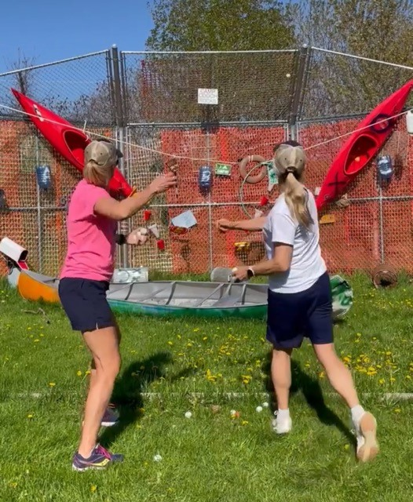
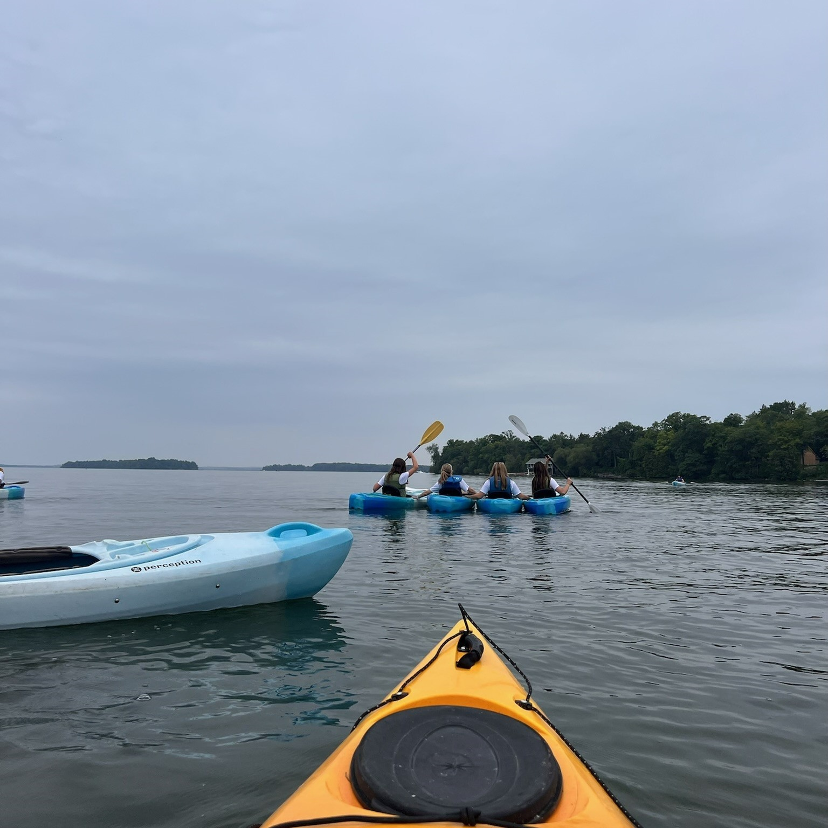
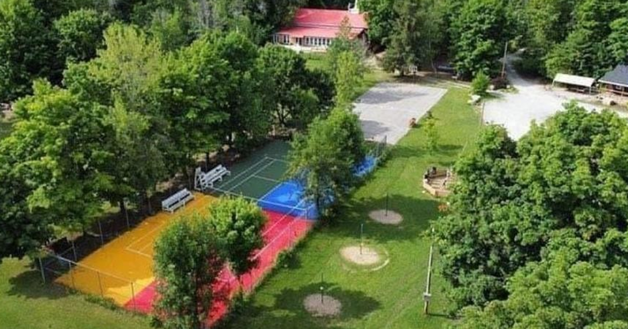
On Location at Camp Couchiching

Slide 9
On Location at Camp Couchiching
Three-day itinerary sample:

Slide 10
On Location at Camp Couchiching – Packing List

Slide 11
Next Steps:
Schools ensure swim tests are completed in advance of their trip
Schools will complete nutritional questionnaires for their class
Parents will ensure each participant has bedding and towels for their trip
Schools will select which activities their groups will participate in and liaise with OELC’s Program Director to customize each group’s leadership experience
OELC will provide each school with their itinerary and program outline in advance of their visit
OELC will provide schools with a packing list for each parent to ensure students have what they need for their visit
Prescription medication sent with students should be kept in the prescription bottle with label and directions for use (please don't put several different medications in one container)

Slide 12
Any questions may be addressed to OELC’s Program Manager, Laura at oelc@oelccaso.com
We look forward to welcoming your students to OELC!

